Slide 1


Slide 2

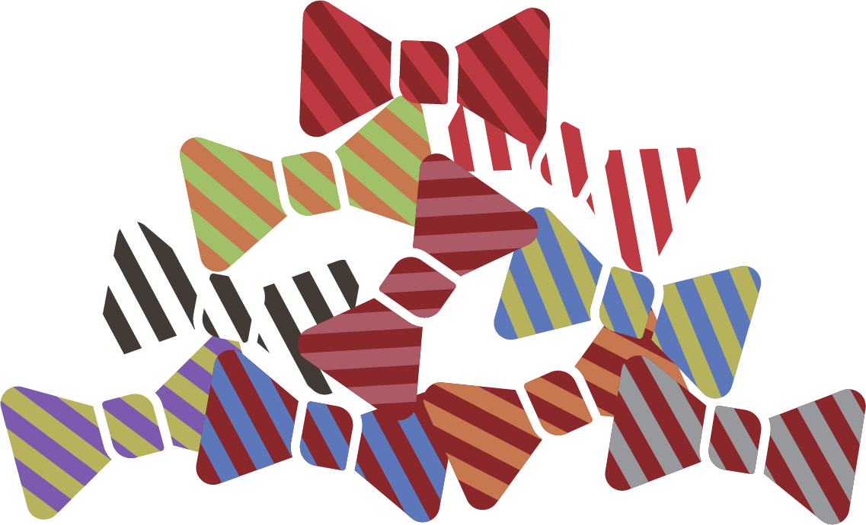
Navigating the Modern Aging Movement
Say It Out Loud Conference May 20, 2024

Slide 3

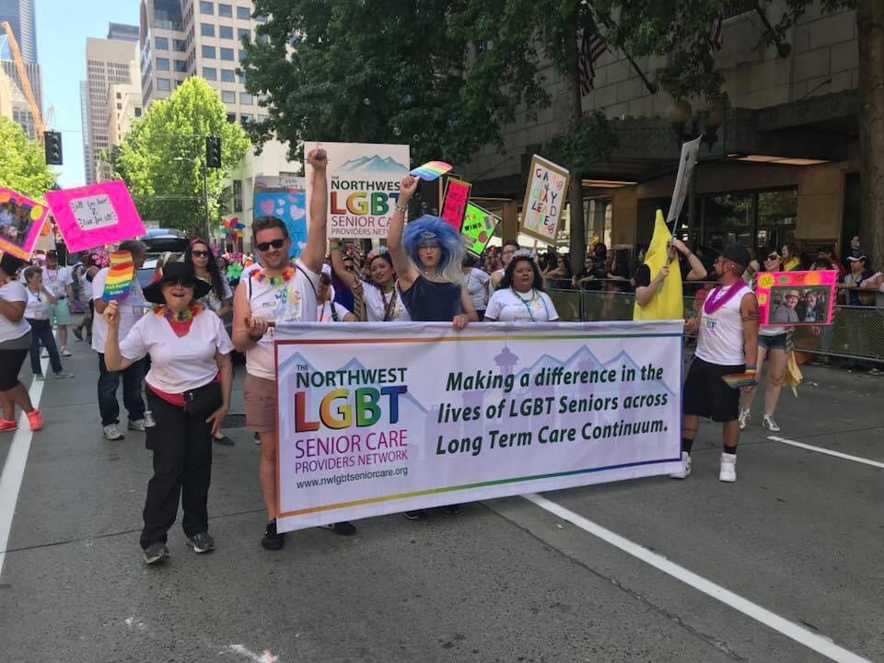
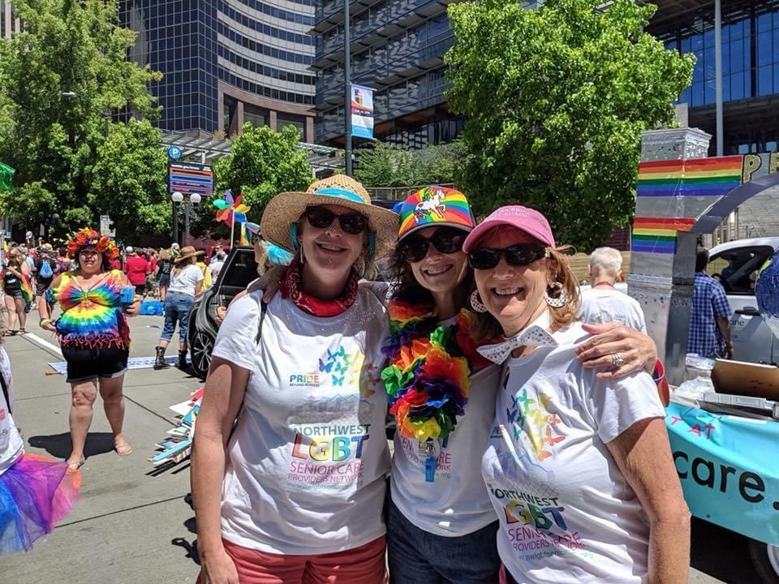
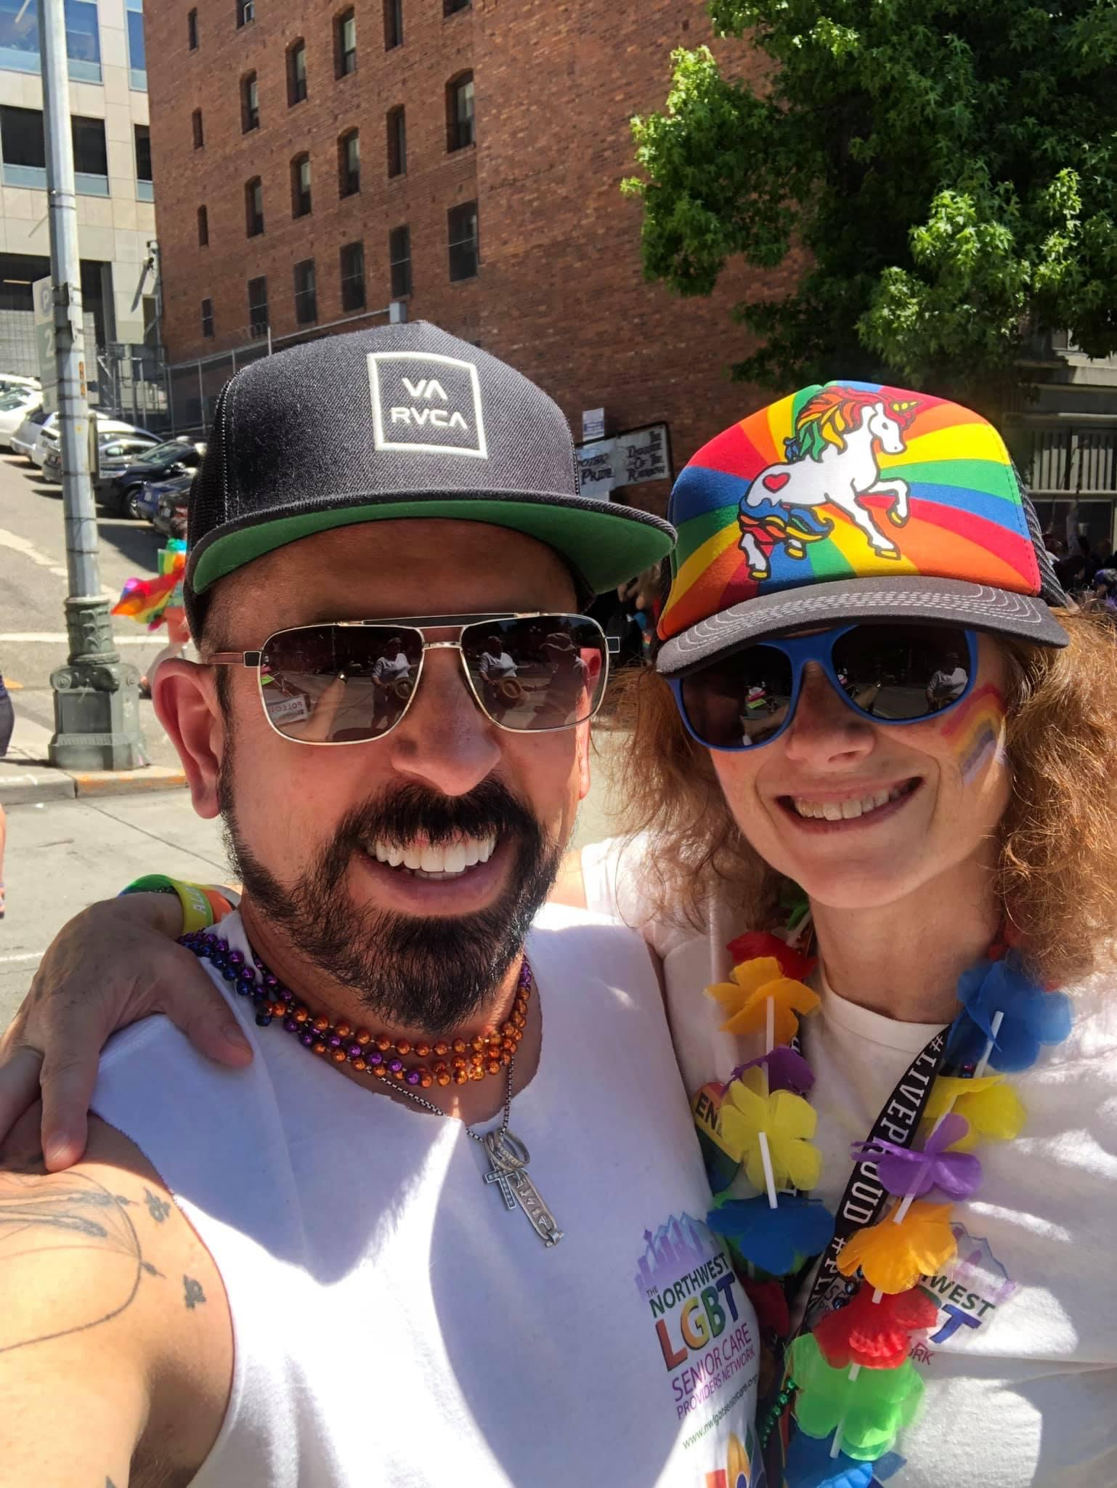
Creating Welcoming Care in Aging Spaces For The LGBTQ+ Community Community
Lesbian, Gay, Bisexual, Transgender, Queer/Questioning, Intersex, Asexual/Agender/Ally

Slide 4
What should you expect to take with you from todays presentation?
New comfort in shifting the conversation on aging from unwelcomed to embraced
Gain a better knowledge of the Modern Aging Movement
Finding your own space in Modern Aging
Getting more comfortable outside your comfort zone
Being more thoughtful in being welcoming for all People & Communities
Better Understanding LGBTQ+ Challenges that are unique in aging
Some pathway ideas for crafting your bespoke aging adventure for yourself

Slide 5
What Are The Pillars Of Modern Aging?
Modern Aging is Defined by Building An Ecosystem Around Aging To Welcome The Aging Process
Don’t wait to get sick to get healthy!
Spend time with more joy and fun in living your life
Change your approach and mindset on what you eat for your own 80,000 meals
Spend less time on mobile devices and email and more time connecting with people
Refusing to define aging as an unwelcome decline in your life
Expecting intelligent design both in physical plant as well as devices for living to maintain purpose from a multi- generational aspect
Find every opportunity to exercise as well as maintain your core

Slide 6
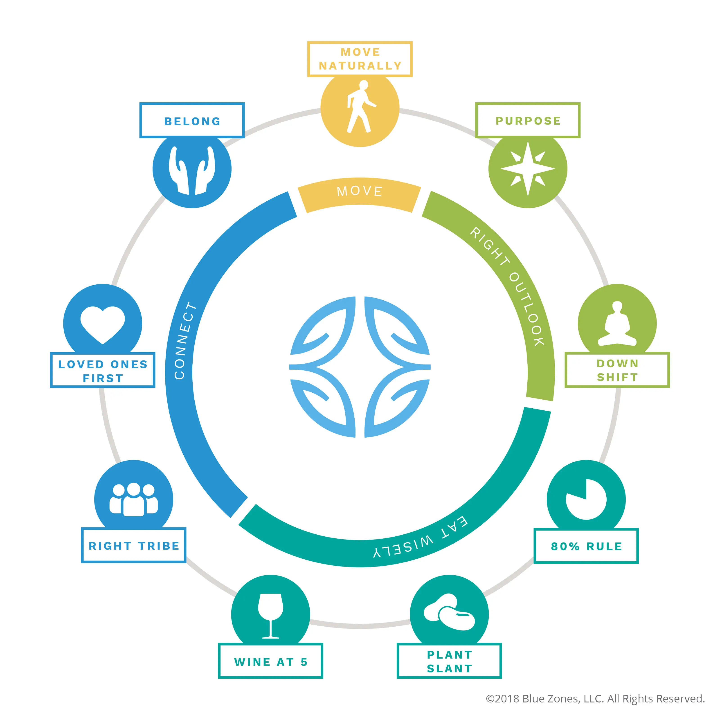
The Lifestyle Habits of the Worlds Healthiest People…
Family Comes First – Belonging to Tribe
Active Local Community Engagement
Following An All or Mostly Plant Slant Diet – 80% Rule
Conducting Physical Activity Every Day – Natural Movement
Elimination Of Smoking
Keeping Stress Levels To A Minimum - Downshift
Maintaining Purpose In Living- Why I wake up!
Barbagia region Sardinia, Ikaria Greece, Nicoya Peninsula,
Costa Rica, Loma Linda CA, Okinawa Japan
The Power 9
Blue Zone Behaviors

Slide 7
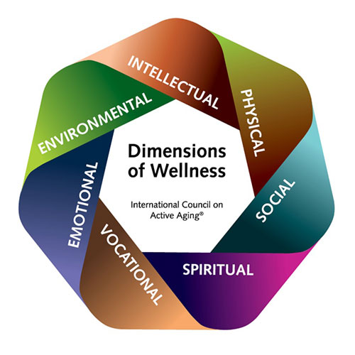
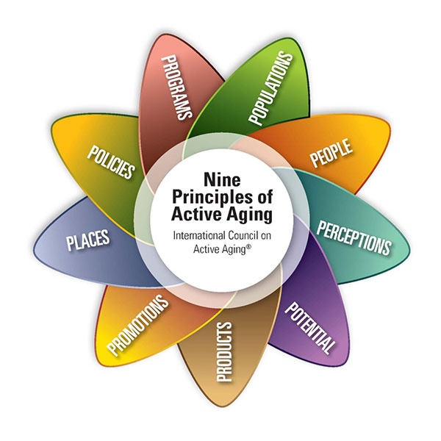
Whole Life Aging For All People -Crafted by the ICAA Think Tank
+

Slide 8
Aging And Sexuality: The Great Myths
Sex is not on the minds of older adults
Romance and physical attraction decline with age
Age related physiological changes make meaningful sexual relationships impossible
One must appear youthful in order to express sexuality or have sex
A Few Important Facts To Consider In Being Proactive As A Resource
Modern Agers are one of the fastest growing STD carriers of chlamydia, gonorrhea, syphilis and trichomoniasis
Modern Agers have the lowest use of condoms - encourage to help reduce STD’s
Erectile dysfunction solutions like Cialis and Viagra – understanding health risks
Women are prone to more vaginal dryness as they age – availability of lubricants
Respect the privacy or personal devices as well as privacy of home activity

Slide 9
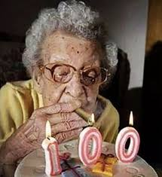

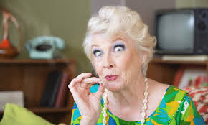
Recreational Drug Use In The Modern Aging Community
Among Modern Agers – 38% men and 25% of women over 50 have used cannabis in the last year
Psilocybin use with Modern Agers can reduce anxiety and depression associated with impending end of life. There have also been extensive studies on use to address dementia as well as pain management
With more legalization there has been an increase in psilocybin use of 250% with people over 65
Must be aware of the risks associated with balance, heart palpitations, confusion and panic/Bad trip

Slide 10
The Stigma Of Aging For LGBTQ Seniors
Where perception can blur the reality
Mainstream senior options are not LGBTQ friendly = Fear for LGBTQ+ Seniors
Although there are laws to protect rights, some locations are less welcoming or outright unfriendly
An LGBTQ Senior may feel rejected by their own community – What is old to you? How about 40!
Perception of deviant lifestyles and copious attention to sexual activity
What are some facts?
LGBTQ+ Modern Agers often do not have family members, but rather rely on Family of choice as a part of their plan
Many if not all Modern Agers you currently serve have LGBTQ+ Family Members or Family of Choice
Many LGBTQ Seniors are not taking steps to plan accordingly for a time when they need assistance with making decisions and legally protecting their choices for end -of -life treatment
We need to better train key decision makers as well as our front-line team members to ensure competency

Slide 11
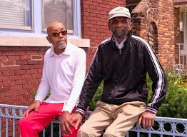
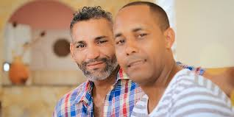
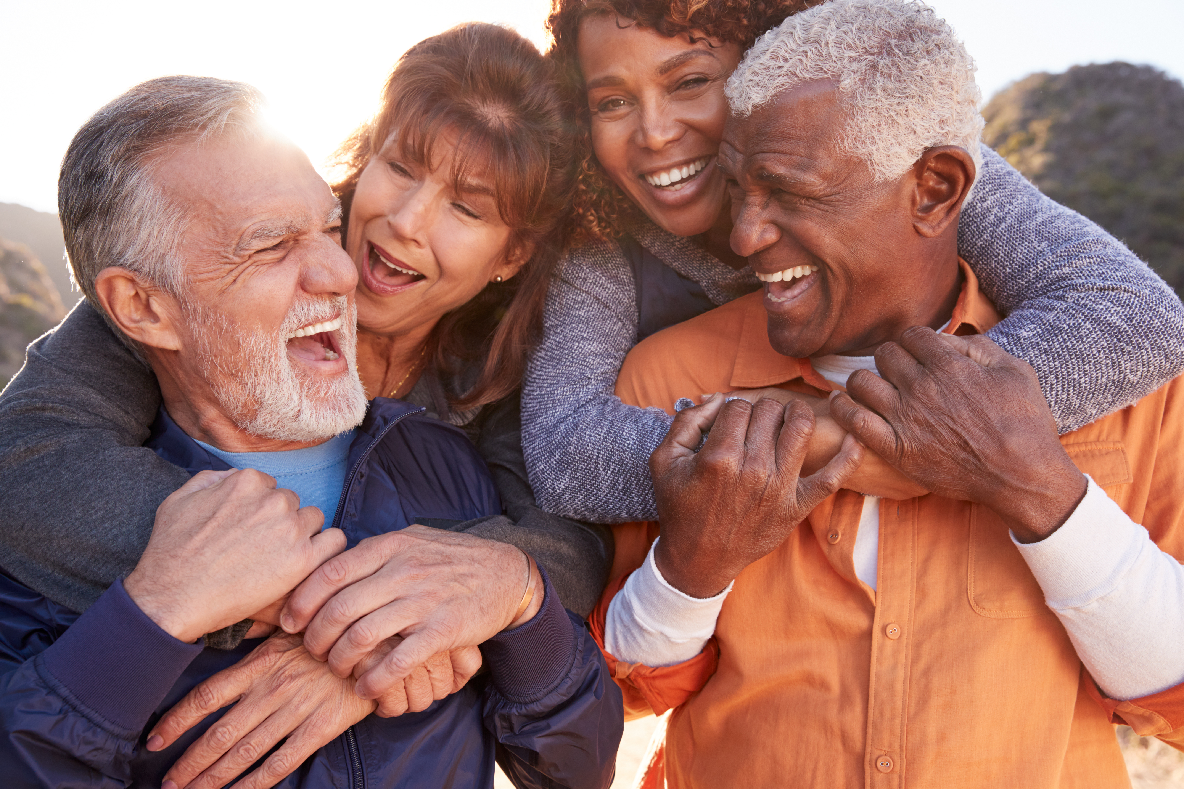
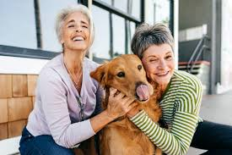
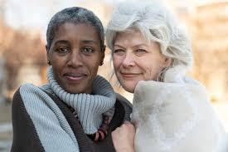
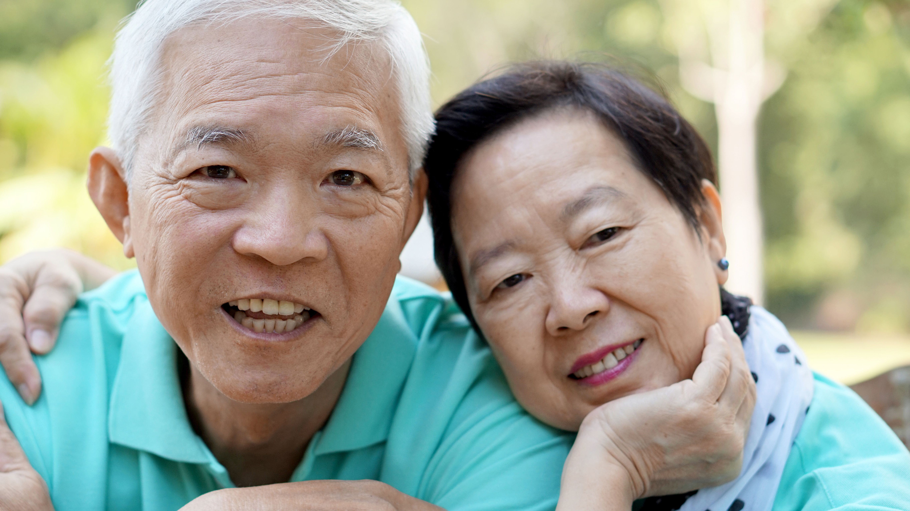
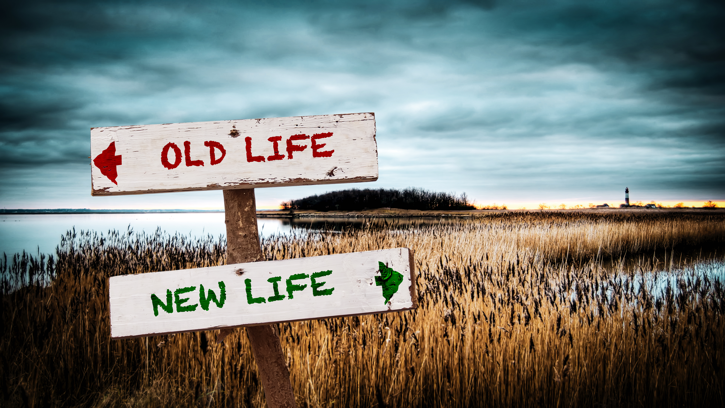
DON’T BE AFRAID TO START!
YOU Can Create Inclusive Modern Aging Philosophy For Your Teams, Resident’s, patient’s & Yourself!

Slide 12
A Few Parting Words In Close Today…
We must always put courtesy before convenience!
The blunder of any individual or organization is more likely carelessness and not incompetence!
Creating Aging Welcoming Spaces for all communities will only help you improve your own happiness and Modern Aging Plan!
Contact Information – David@davidhaack.net / 206-849-3511
Questions?
Thank you, Fabulous attendees!

