Slide 1


Enhancing LGBTQIA+ Healthcare Access: Insights from Molina Healthcare and Health Care Authority
Erica Marchbank, Case Manager/LGBTQIA+ Health Navigator, Molina Healthcare
Lisa Little, RN, Occupational Nurse Consultant, Health Care Authority, TransHealth Program Manager
Scott Swan, LMHC, Clinical Programs Manager, Behavioral Health, Molina Healthcare

Slide 2
Agenda
Overview of Managed Care Organizations, specifically Molina, in regards to LGBTQIA+/Gender Affirming Care within Washington State
Molina in the community/Pride events
Overview of Health Care Authority and TransHealth Program
Questions and Answers

Slide 3

Managed Care Organizations in Washington State

Slide 4

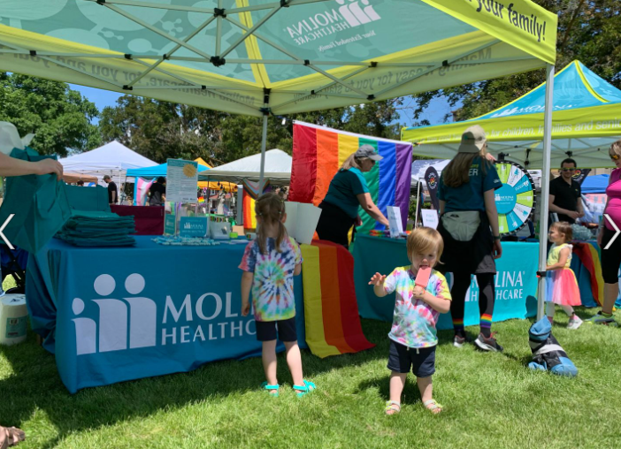


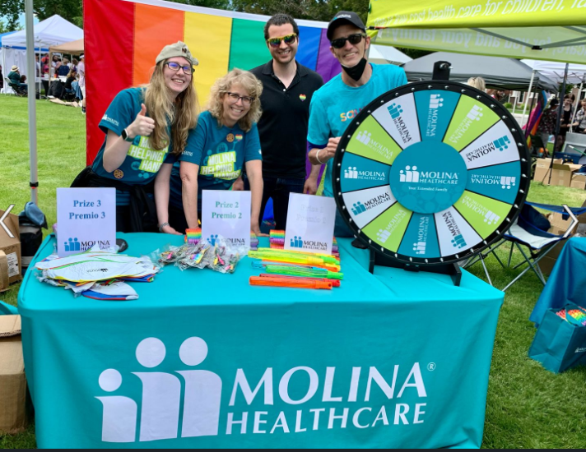

Community Engagement
Notes:
Scott

Slide 5





Community Engagement
MHWCommunity.Engagement@MolinaHealthCare.Com

Slide 6

Care Management Overview
*Umbrella term that includes care coordination and case management
Care Coordination (CC)
Case Management (CM)
  Focuses on short term or intermittent needs
  May be provided by unlicensed/non clinical staff
  Access to care/services addressing social needs
  Improving clinical outcomes
  Increasing self management skills
  Voluntary/Member Choice
  Focuses on longer term support (approx. 3-6 months engagement)
  Provided by licensed/clinical staff
  Assists members in managing complex healthcare needs
  Goal setting based on individual’s priorities
  Integrated care planning with member consent
  Voluntary/Member Choice
  CM services are voluntary, and we must have member/guardian consent to provide CM.
Notes:
Care Management is overarching definitions of Health Homes, other CM programs, etc. Case management is a specific contractually defined program, staff more clinically licensed. Care Coordination can be any short term brief assistance provided by MCO, staff may not be licensed. Clients may come and go from CM. Once current goal is reached, may discharge from CM. If new goals arise, CM may be requested again.
Ask for “what kind of help you are looking for” rather than worrying about which term is used. Clear about your looking for – we can be clear about how we can help. It is the communication piece.
Consent- call out verbal consent to DDA CM is appropriate and can be sufficient.
For BHSO members – we would still help them access services by working with the “coverer” of PH.

Slide 7
Care Management Overview
*Umbrella term that includes care coordination and case management
Tips for requesting Care Coordination
Be Specific- what kind of help are you seeking?
Please get consent prior to referral (if possible).
For PH CM referrals for BHSO members- the MCO would coordinate with the entity covering PH services.
Triage team at MCO will determine the best course of action to get needs met timely.
Notes:
Consent can be verbal.

Slide 8
LGBTQIA+ Health/Gender Affirming Care Navigator Role

Slide 9

Apple Health (Medicaid)
Transhealth Program
Lisa Little, RN
Occupational Nurse Consultant
Clinical Quality and Care Transformation

Slide 10
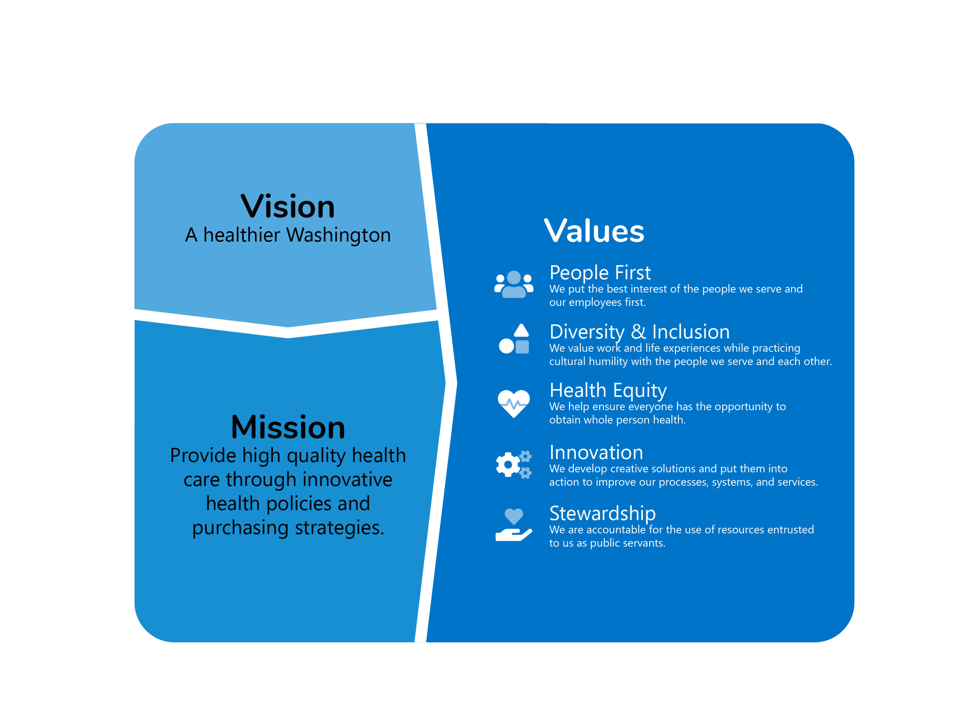

Slide 11
About the Health Care Authority
The Washington State Health Care Authority (HCA) purchases health care for more than 2 million Washington residents through:
  Apple Health (Medicaid)
  The Public Employees Benefits Board (PEBB) Program
  The School Employees Benefits Board (SEBB) Program
Apple Health covers preventative care, like cancer screenings, treatment for diabetes and high blood pressure, and many other health care services, including transgender and non-binary health care

Slide 12





Managed care in Washington
Over 2 million Washingtonians are enrolled in Apple Health. About 85% of them are enrolled in managed care.
The transhealth program is managed as a partnership between HCA and MCOs for managed care enrolled clients
Notes:
Managed care improves quality and manages costs • Medicaid managed care models typically yield cost savings. 1 • Medicaid managed care improves health plan performance, health care quality, and outcomes for people and families.

Slide 13
History of Transhealth program
Transhealth services covered in WA prior to 2015
In 2015 WA removed exclusions for gender reassignment surgery and other surgeries related to transhealth
In 2021, SB 5313 was passed and affirmed/established that health carriers and HCA may not deny coverage for medically necessary gender affirming treatment or apply blanket exclusions to gender affirming treatment.

Slide 14
Transhealth program overview
WA Apple Health Medicaid covers many services for transhealth, including but not limited to:
  Primary care
  Hormone therapy and other medications
  Behavioral health
  Transhealth procedures, including but not limited to gender confirmation surgery, facial gender confirmation surgery, hair removal
Provides coverage for medically necessary gender-affirming treatment.
Adhere to WPATH guidelines—currently SOC 7—updating to follow SOC 8 more closely.

Slide 15
Transhealth program details
Managed care clients have most services covered by their managed care organization as with other health care services (e.g., primary care, hormone therapy, behavioral health, and speech therapy services)
Specific gender-affirming treatment procedures (such as surgical procedures and hair removal) are covered directly by Apple Health Fee For Service (not the MCO).
  These services may require a referral from the primary provider and a prior authorization from the servicing provider.
  Prior authorization requests are reviewed on a case-by-case basis for medical necessity

Slide 16
Partnerships
HCA holds regular meetings with stakeholders, MCOs, and providers.
HCA works closely with providers, including outreach to support access.

Slide 17
Resources
Washington Administrative Code: WAC 182-531-1675
Billing guide: Transhealth program billing guide (wa.gov)
Transhealth program information: Transhealth program | Washington State Health Care Authority

Slide 18

Contact
Email:
applehealth.transhealth@hca.wa.gov

Slide 19



Questions and Answers

Slide 20
Thank You!
Erica.Marchbank@Molinahealthcare.com
Lisa.Little@HCA.wa.gov
Scott.Swan@Molinahealthcare.com
Interested in connecting a member to a LGBTQIA+ Health Navigator at Molina?
MHWCMReferrals@MolinaHealthCare.com

